Slide 1
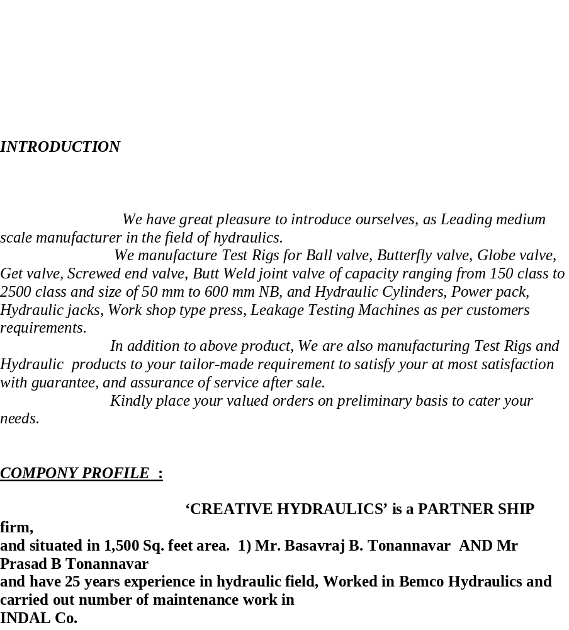

Slide 2
TEAM WORK.
NAME DESIGNATION.
Mr.Basavaraj B. Tonannavar. Director(Design & Development)
Mr.Prasad B.Tonannavar Director(Marketing)
B) OFFICE STAFF.
Mr. Praveen Patter Production Manager.
Mr.Deepak Kammar. Supervisor.
Mr.Shridhar Sutar. Design.
Mr.Jagadesh Kulkarni. Accounts
Mr. Sunil Pail. Accounts.
WORKING STAFF.
1) Fitters 4 Nos
2) welders. 2 Nos.
3) Electrician 1 No
4) Semi skilled workers. 4 Nos.
5) Helpers. 3 Nos.

Slide 3
The *CREATIVE HYDRAULICS* Co. is equipped with following machineries.
*Lathe Machines: 3Nos.
*Drilling Machine: 1No.
*Arc Welding Machine; 2Nos.
*CO2 Welding Machine: 1 No.
*Boring Machine; 1No.
*Grinding machine; 1 No.
*Over Head Crane Of 10 Tons Capacity: 1No. Along with all measuring instruments.

Slide 4
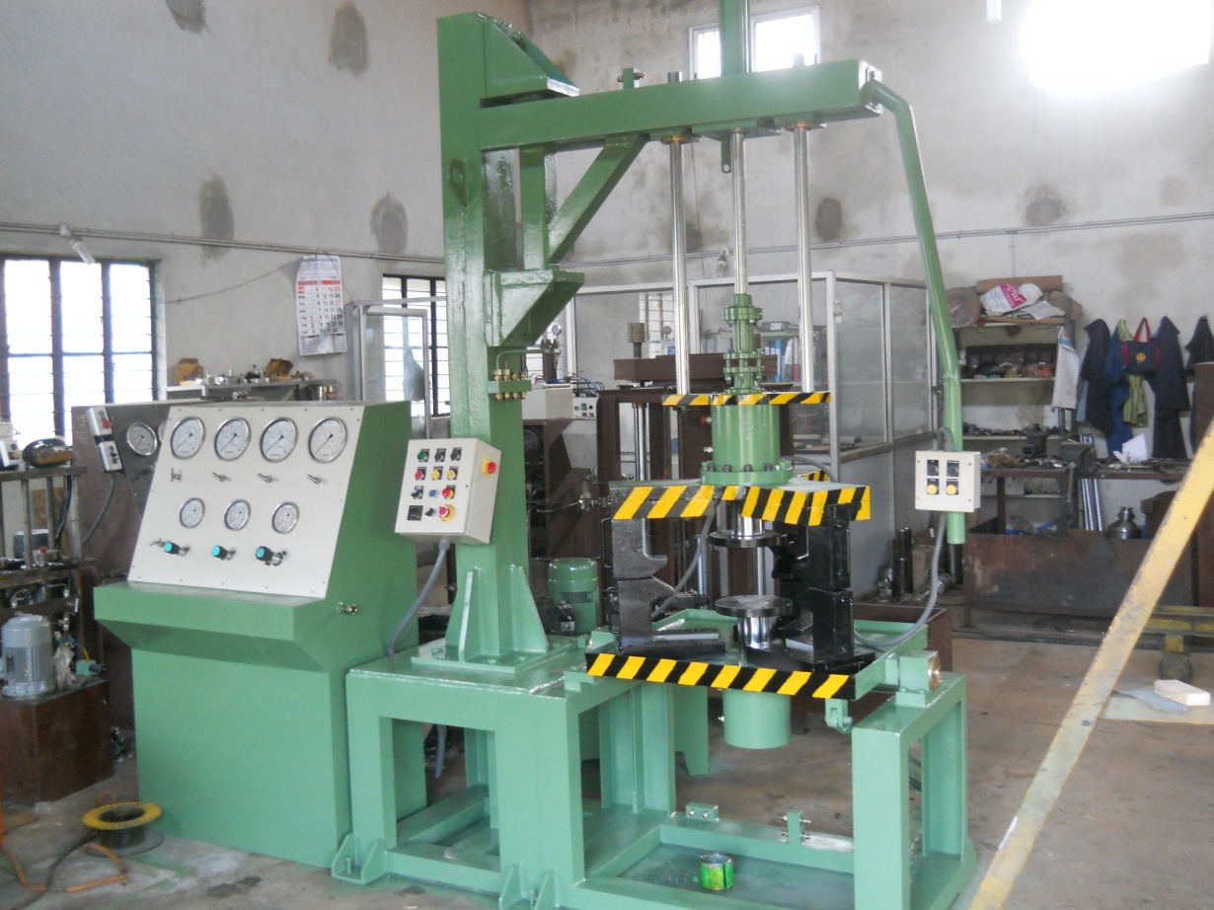
CREATIVE HYDRAULICS
BELGAUM
HYDROSTATIC NON
COMPRESSIVE TEST RIG.
Capacity-10MT to 130MT.
Type of valve can be tested.-All kind of flange end valves.
Size of valve to be tested.-1/2” to 4”(10MT), 1” to 6”(20MT)., 2” to 8”
(40MT),6” to 12”(75MT),10” to 16”
(130MT).
Class-#150 to #600(As per Tonnage) More then 600# will be manufactured as per requirement of customer.
Operation- Semi Automatic and Automatic with PLC & SCADA.

Slide 5
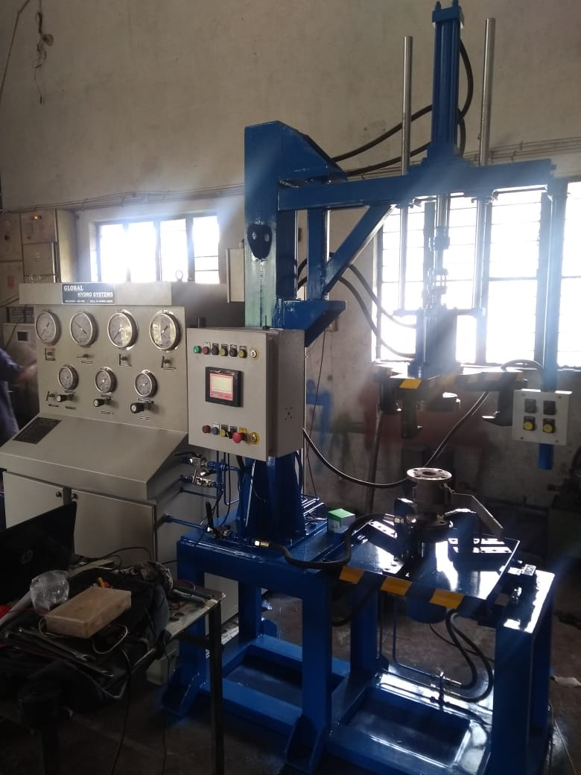
CREATIVE HYDRAULICS
BELGAUM.
HYDRO STATIC NON COMPRESSIVE TEST RIG .
CAPACITY- 20 MT
TYPE OF VALVES –Flange End Valves.
Size-1/2’ TO 4”
Class-150 to 600
Operation- Semi automatic with MINI PLC.

Slide 6
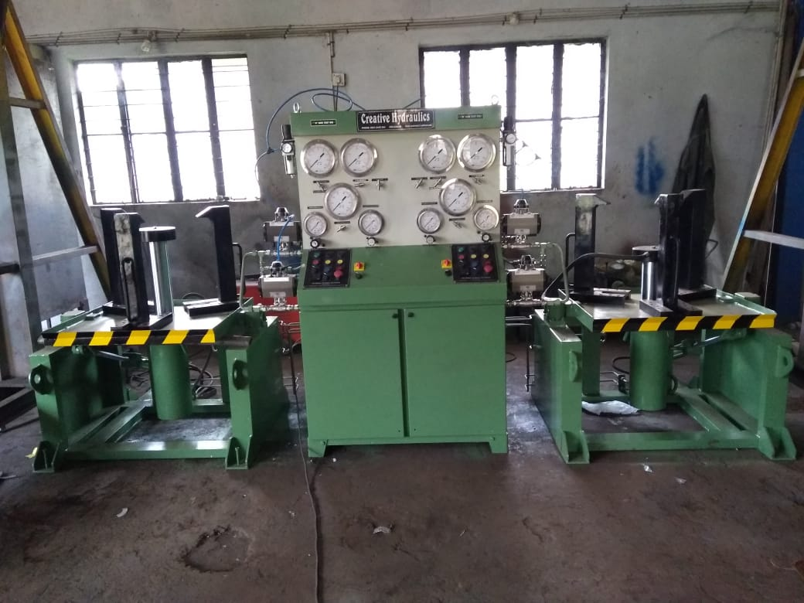
CREATIVE HYDRAULICS
BELGAUM
HDROSTATIC COMPRESSIVE TEST RIG FOR BUTTERFLY VALVES. CAPACITY 75MT(TWO STATIONS.
SIZE-2” TO 12” CLASS PN10 ,150 &300.

Slide 7
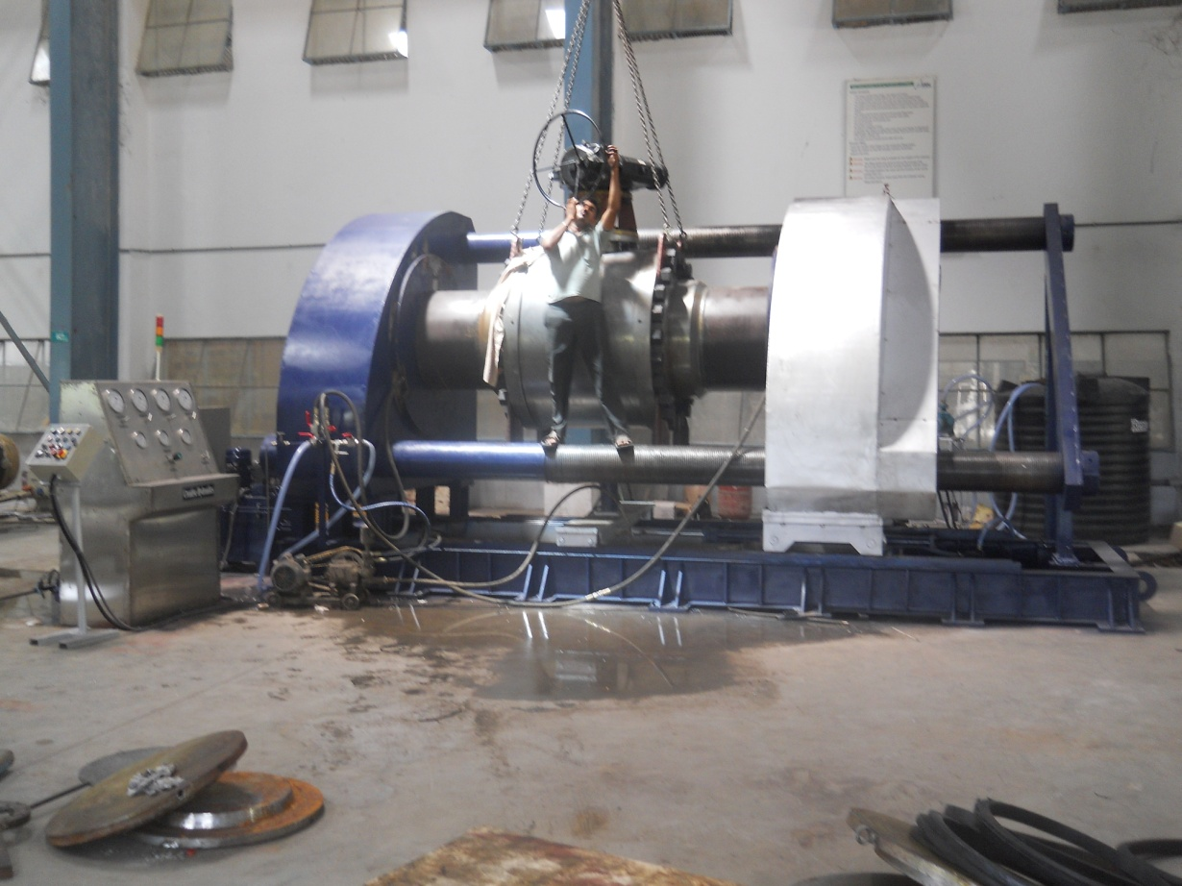
CREATIVE HYDRAULICS
BELGAUM.
HYDROSTATIC NON COMPRESSIVE TEST RIG HORIZONTAL TYPE.(BORE SEALING VALVE)
1300MT Horizontal Non Compressive Test Rig.
Type of valve can be tested-Trun-
nion mounted ball valves.
Size of valves to be tested-20” to 36”(#150 to # 600).

Slide 8
CREATIVE HYDRAULICS
BELGAUM.
HYDROSTATIC COMPRESSIVE TEST RIG VERTICAL TYPE(MULTISTATION)
20MT Vertical Compressive Test Rig.
Type of valves can be tested-Forged valves (Socket ,Screwed,Buttweld &
Flange end valves.)
Size of valve to be tested-1/2” to 2”.
Class-150# to 2500# (As per Tonnage)for higher size will be manufactured as per requirement of customers.
Operation -Semi automatic & Automatic with PLC & SCADA.

Slide 9
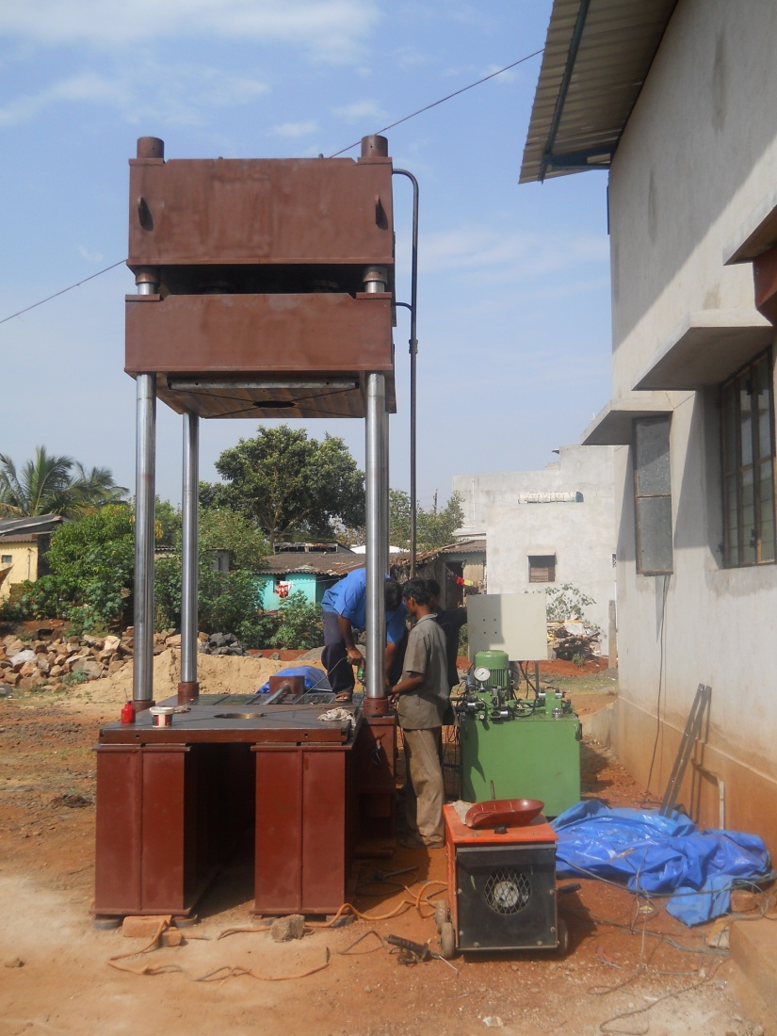
CREATIVE HYDRAULICS
BELGAUM.
TIE-ROD TYPE PRESS.
Capacity-Min 50MT to 2000 MT.
Size of machine can be manufactured as per customer requirements & applications.

Slide 10
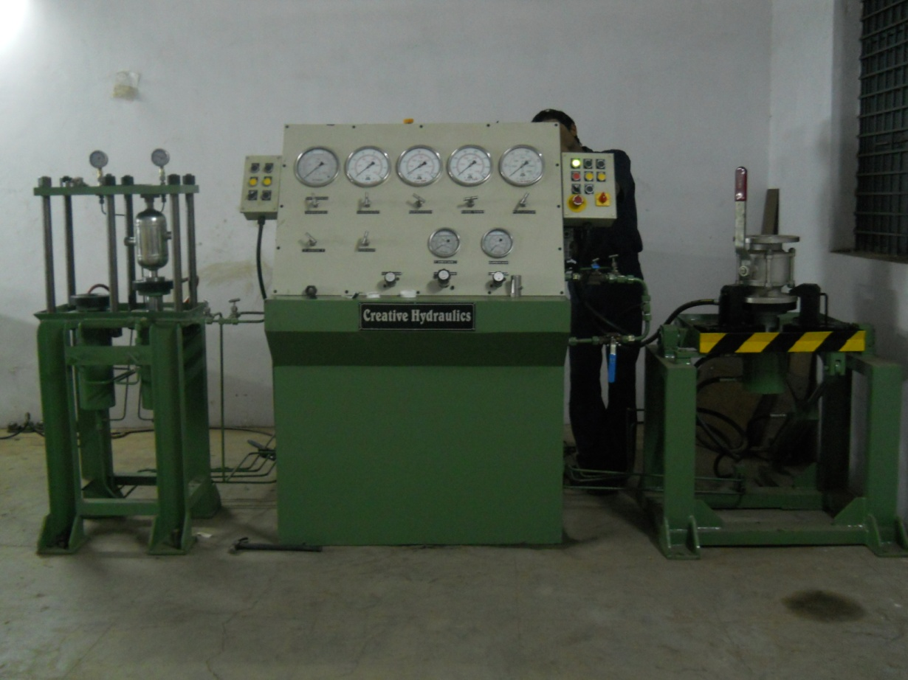
CREATIVE HYDRAULICS
BELGAUM.
m
HYDROSTATIC COMPRESSIVE AND NON-COMPRESSIVE TEST RIG(Two stations)
Capacity-20MT
Type of valve can be tested-All type
of forged valves & Flange end valves.
Size-1/2” to 2” Forged valve & 2” to 6” Flange end valves.
Class-1/2” to 2” #150 to #2500 for forged valves.
Class-2” to 6” #150 to #300 for flange end valves.

Slide 11
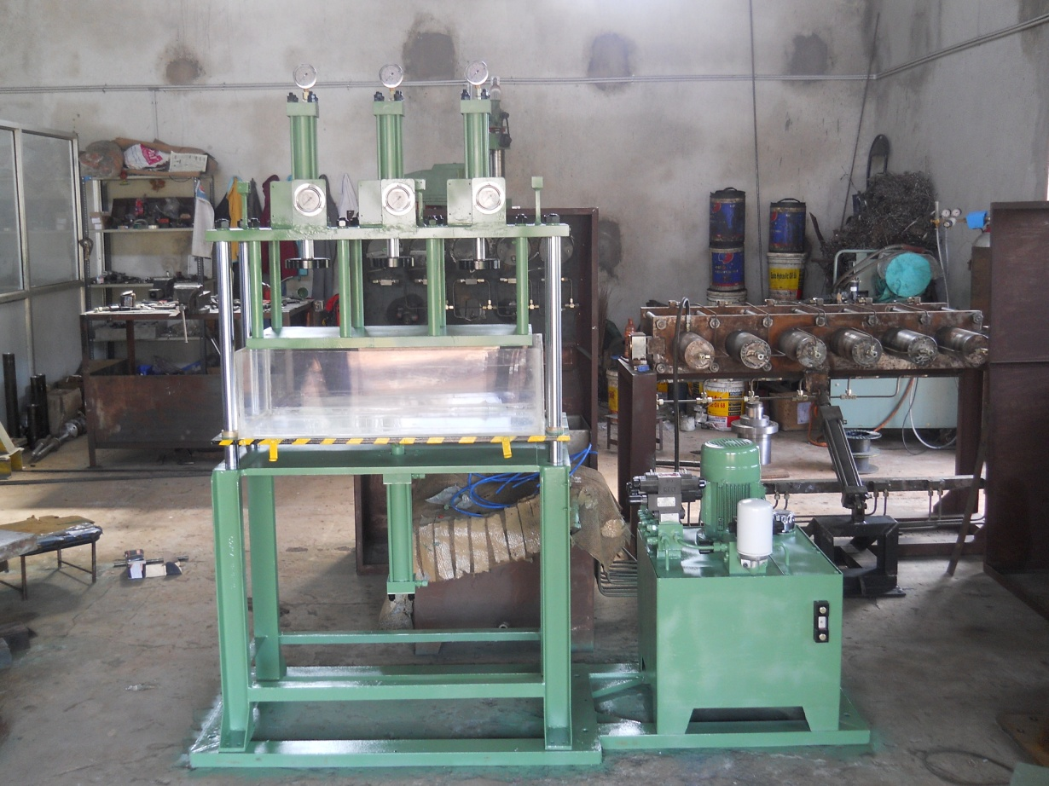
CREATIVE HYDRAULICS BELGAUM.
spm
HYDROSTATIC COMPRESSIVE TEST RIG OF CAPACITY 2TON
TYPE-AIR UNDER WATER(THREE STATION)
SIZE-2” TO 6”
MAX AIR PRESSURE-7KG/CM SQ.
As per Tonnage for higher size will be manufactured as per customer requirement .
Operation-Semi automatic and Automatic With PLC & SCADA.

Slide 12
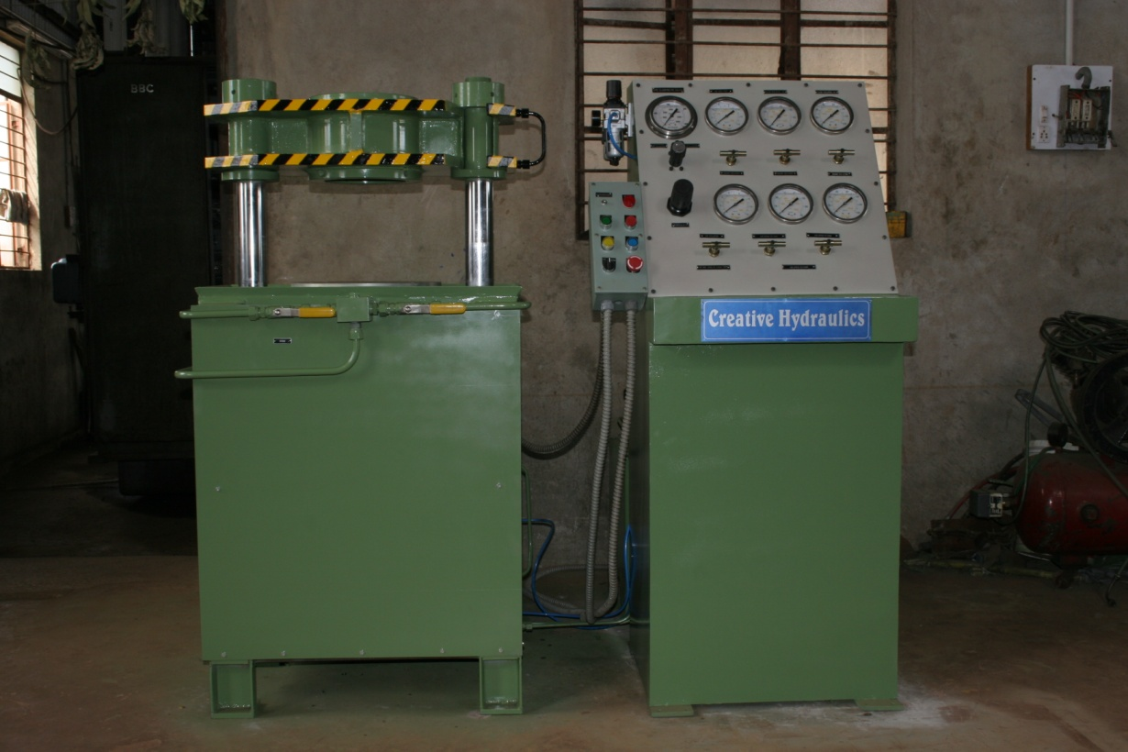
CREATIVE HYDRAULICS BELGAUM.
HYDROSTATIC COMPRESSIVE TEST RIG OF CAPACITY 75MT.
Type of valve to be tested –Butterfly valves.
Size-2” to 12”
Class-150 to 300(As per Tonnage)
For higher size as per requirement
of customers.
Operation- manul

Slide 13
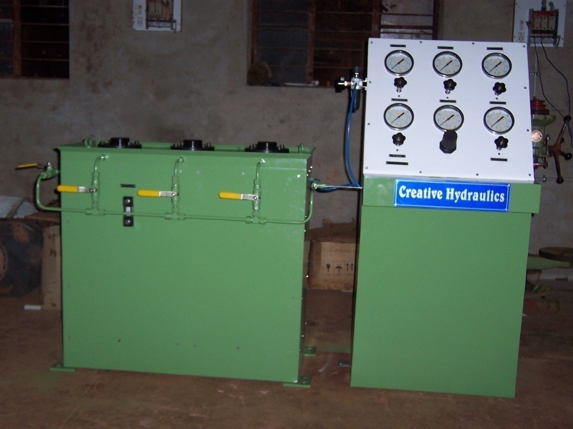
CREATIVE HYDRAULICS
BELGAUM.
HYDROSTATIC NON COMPRESSIVE TEST RIG.
Types of valves –Screwed end ball valve.
Size – ½” to 4”
Class – 150 to 300.
Operation- Semi automatic .

Slide 14
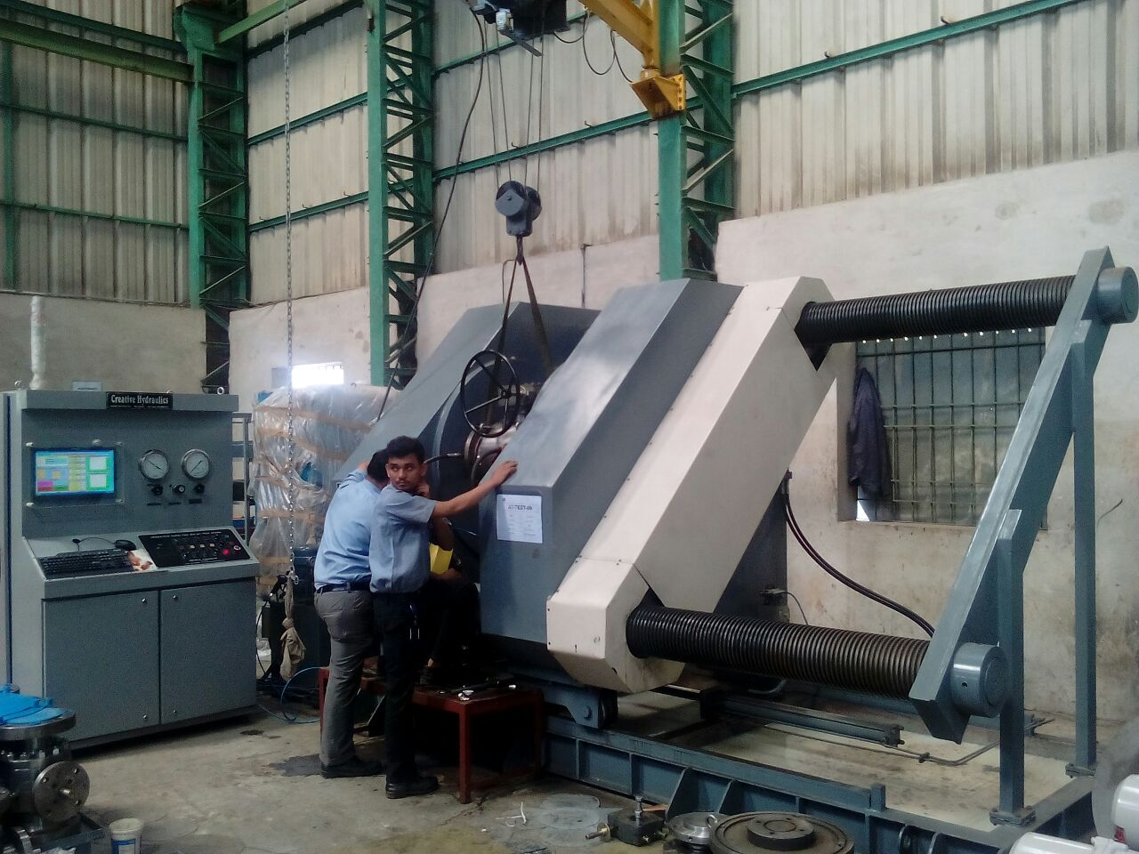
CREATIVE HYDRAULICS BELGAUM.
HYDROSTATIC NON COMPRESSIVE TEST RIG HORIZONTAL TYPE OF CAPACITY 900MT.
Type of valve-Flanged end and Butt weld end valves.
Size-12” to 24”
Class- 150 to 900
Operation- Automatic with PLC &
SCADA. Fully automatic.

Slide 15
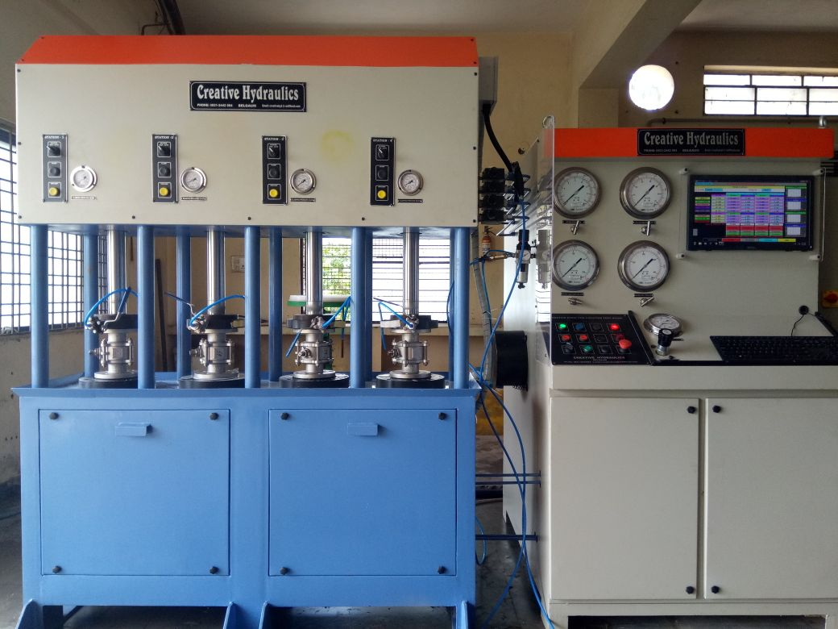
CREATIVE HYDRAULICS BELGAUM
HYDRO STATIC NON COMPRESSIVE TEST RIG CAPACITY 20 MT.
Type of valves forged valves Butt weld end/socket end/Screwed end/Flange end.
Class-150 to 2500
Operation-PLC & SCADA fully automatic.

Slide 16
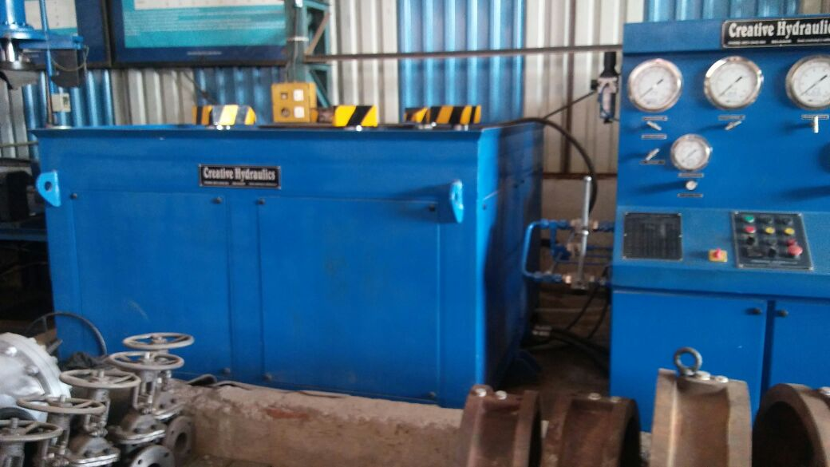
CREATIVE HYDRAULICS BELGAUM.
HYDROSTATIC COMPRESSIVE TEST RIG CAPACITY -350 MT.
Type of valves-Butterfly valves
Size-18” to 42”
Class -150
Operation Manual ./Semi automatic.

Slide 17
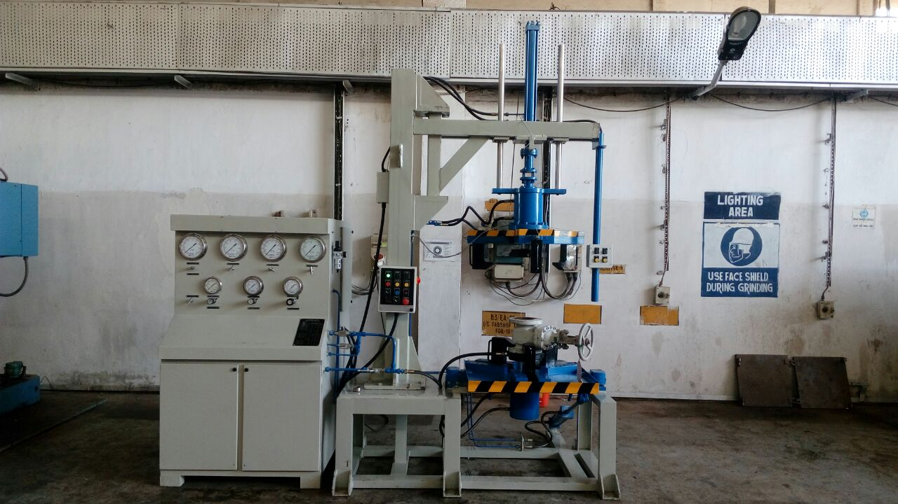
CREATIVE HYDRAULICS BELGAUM.
HYDROSTATIC NON COMPRESSIVE TEST RIG .
CAPACITY-40MT
Type of valves-flanged end valves.
Size-2” to 8” Class -150 to 300
Operation- Manual

Slide 18
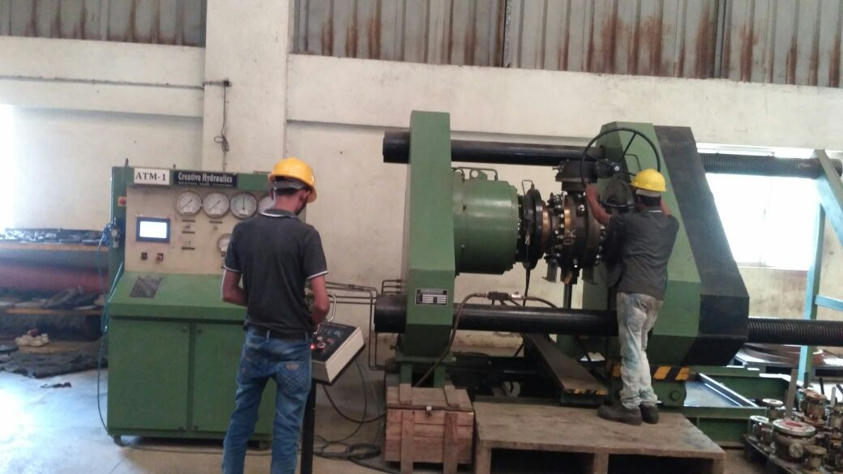
CREATIVE HYDRAULICS
BELGAUM
HYDRO STATIC NON CONPRESSIVE TEST RIG CAPACITY-600 MT
TYPE OF VALVES-GATE/GLOBE /BALL VALVES.
SIZE-6” TO 24”
CLASS-150 TO 600
OPERATION –SEME AUTOMATIC
WITH PLC/HMI BASED.

Slide 19
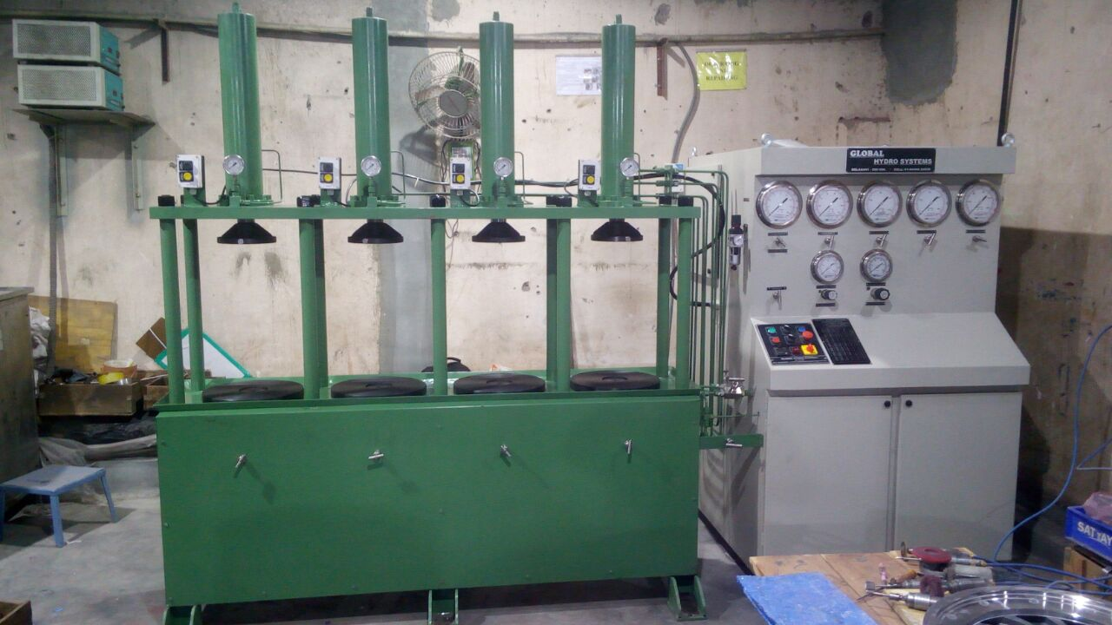
CREATIVE HYDRAULICS BELGAUM
COMPRESSIVE TEST RIG FOR FORGED VALVES .
CAPACITY-20MT
SIZE-1/2” TO 4”
CLASS 1/2 “ TO 2” -2500
CLASS 3” TO 4” -600
OPERATION
MANUAL/AUTOMATIC

Slide 20
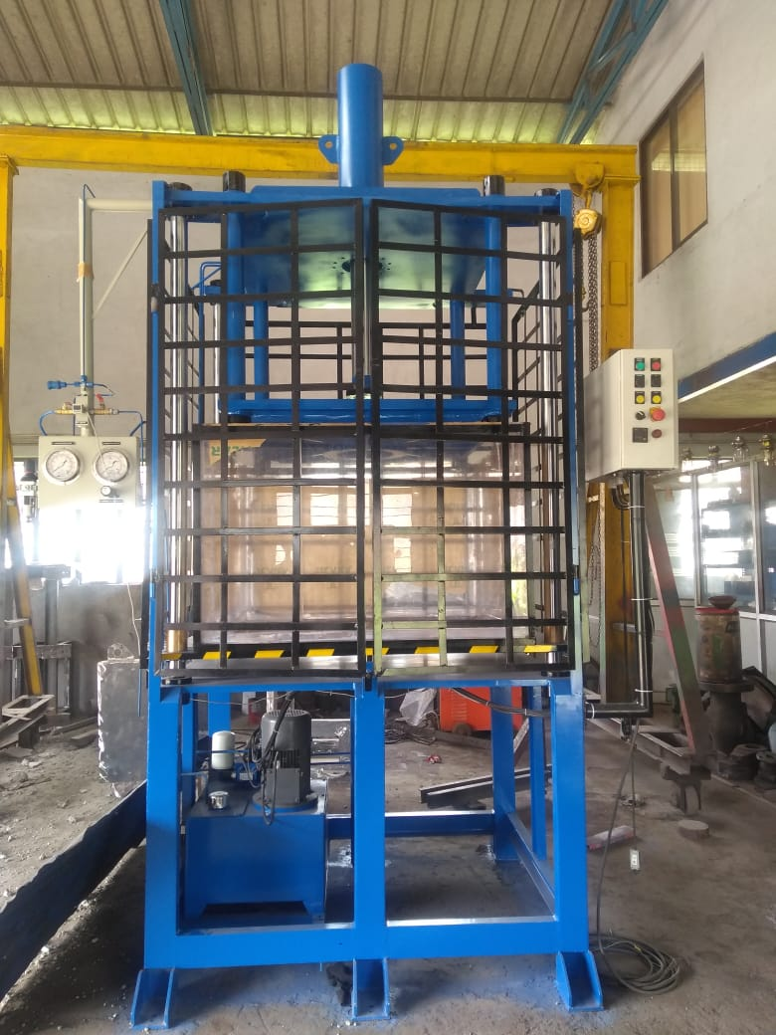
CREATIVE HYDRAULICS
BELGAUM
HYDROSTATIC COMPRESSIVE
TEST RIG (AIR UNDER WATER)
Capacity-30mt
Type of Component Aluminum casting Bodies or components.
Max size- Dia 800mm
Max- Air pressure -7 KG/CM SQ

Slide 21
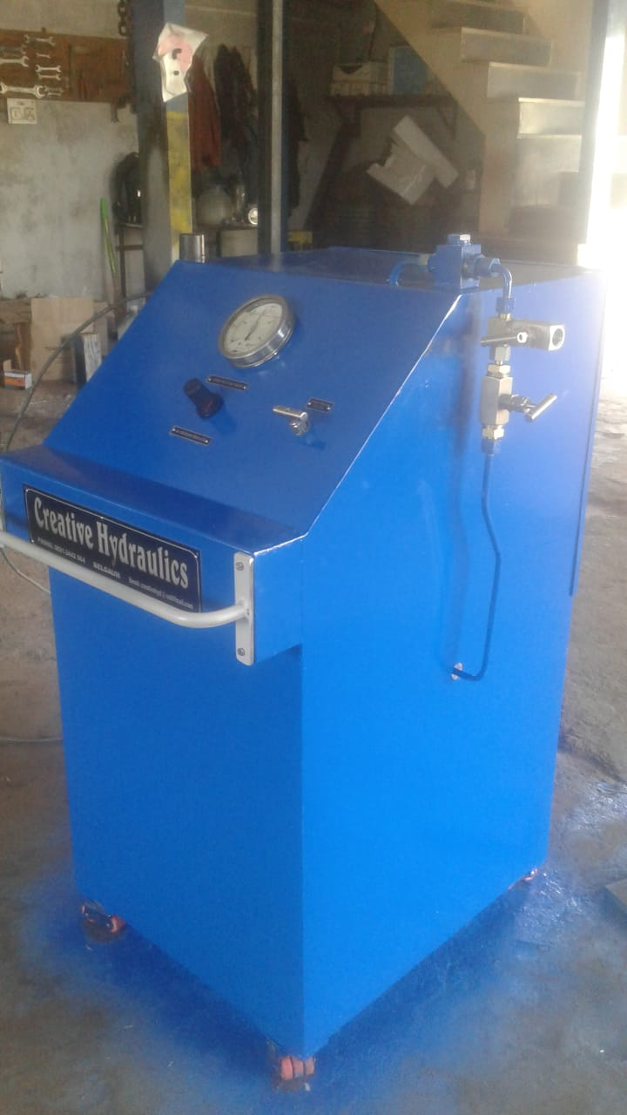
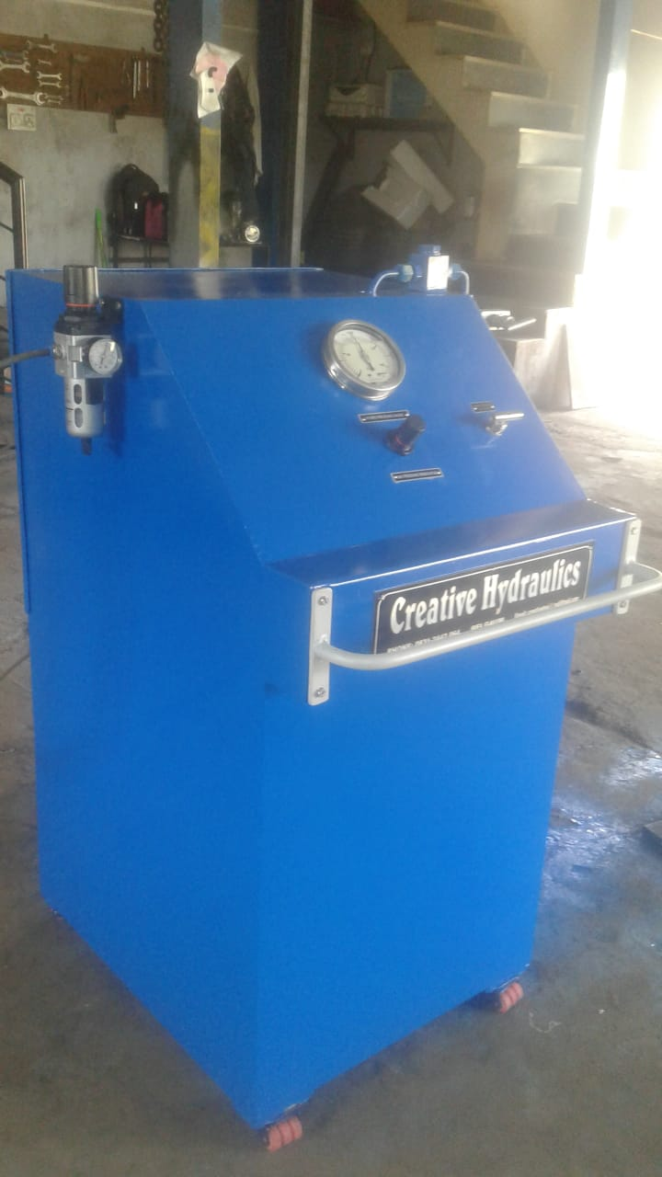
CREATIVE YDRAULICS. BELGAUM.
Portable Trolley for pressure Testing Min Pr-10Bar and Max- 700 Bar.
Portable Pr ,Testing Trolley
Portable Pr , Testing Trolley

Slide 22
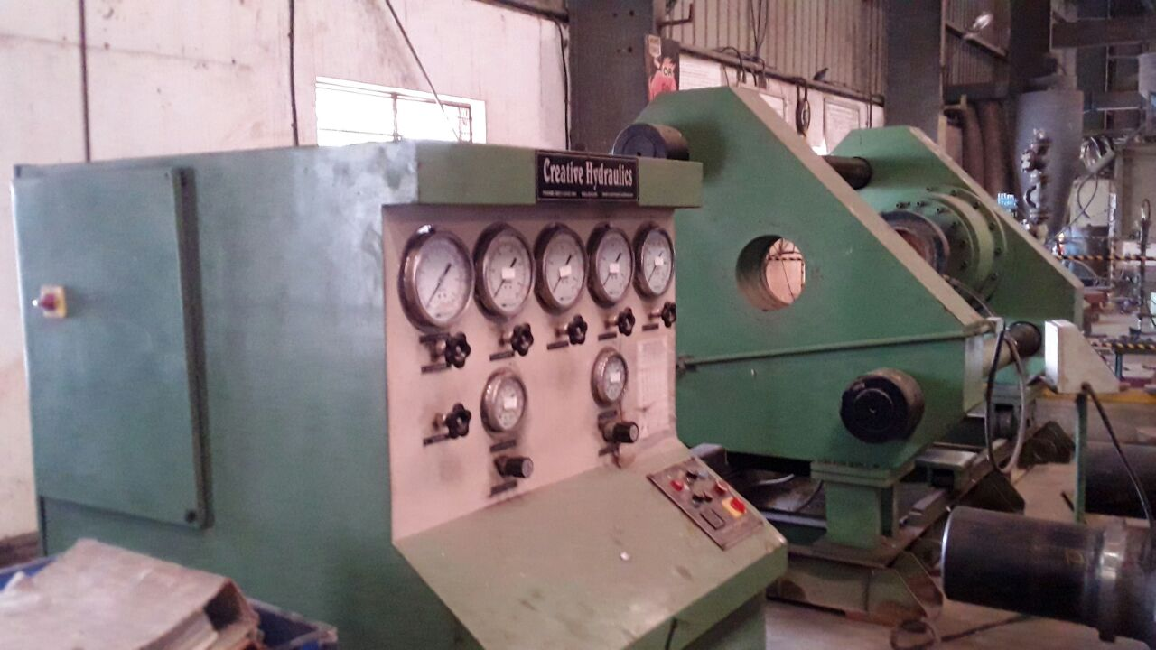
CREATIVE HYDRAULICS
BELGAUM.
HYDROSTATIC COMPRESSIVE TEST RIG .
TYPE OF VALVE -BUTTWELD END VALVES.
SIZE-4” TO 12”
CLASS -150 TO 15OO
OPERATION-Manul/Semi automatic/Automatic with PLC SCADA.
As per customer for above size and class we can manufacture.

Slide 23
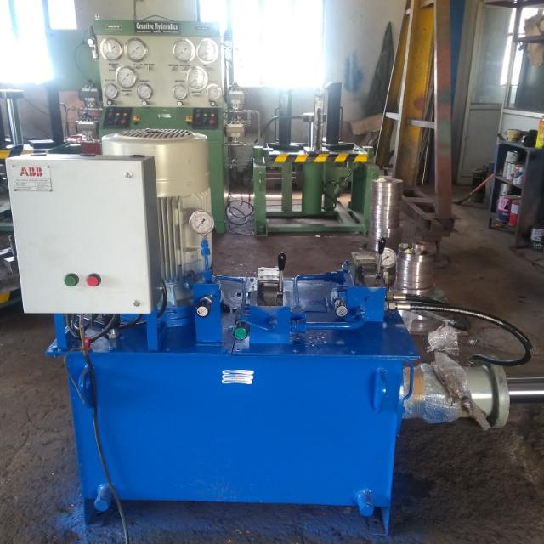
CREATIVE HYDRAULICS BELGAUM.
POWER PACK OF 15 HP TESTING VALVE AND ACTUATORS .
AS PER CUSTOMER REQUIREMENT WE CAN MANUFACTURE POWER PACKS ,CYLINDERS FOR SPECIAL PURPOSE MACHINE TOOLS AND DIFFERENT OPERATIONS .

Slide 24
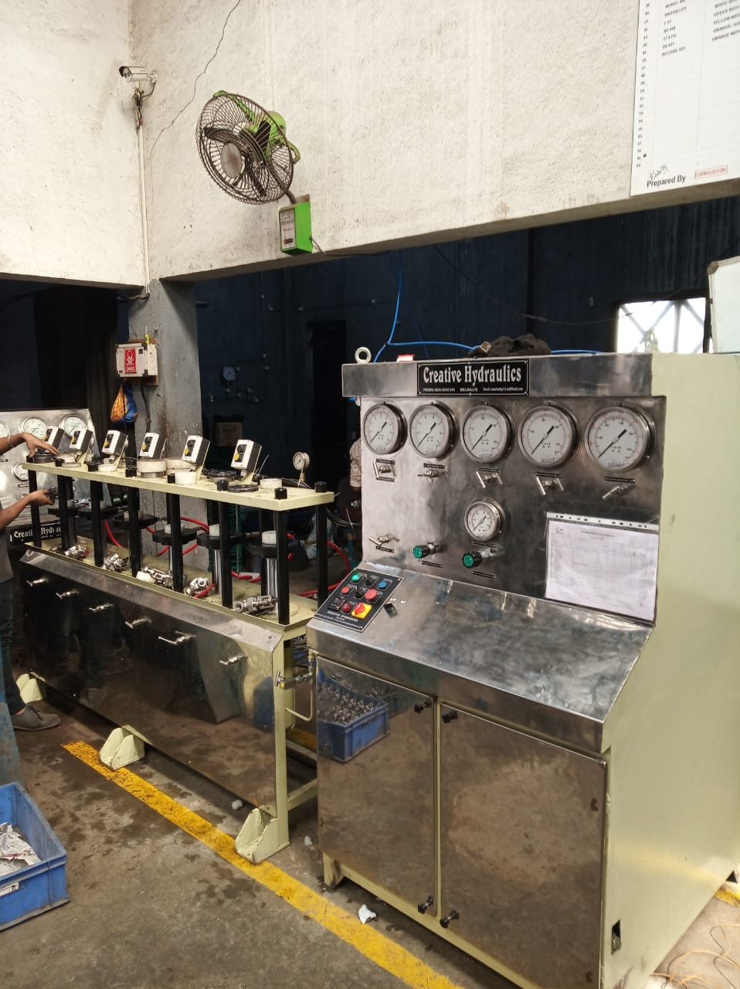
Creative Hydraulics Belgaum
Compressive Test Rig for Forged valves.
Capacity- 20 MT Each station.
Type of valves- Forged B/W,S/W ,Screwed End, Flange end etc.
Operation . Manual/Semi auto/ Automatic with PLC & Scada.

Slide 25
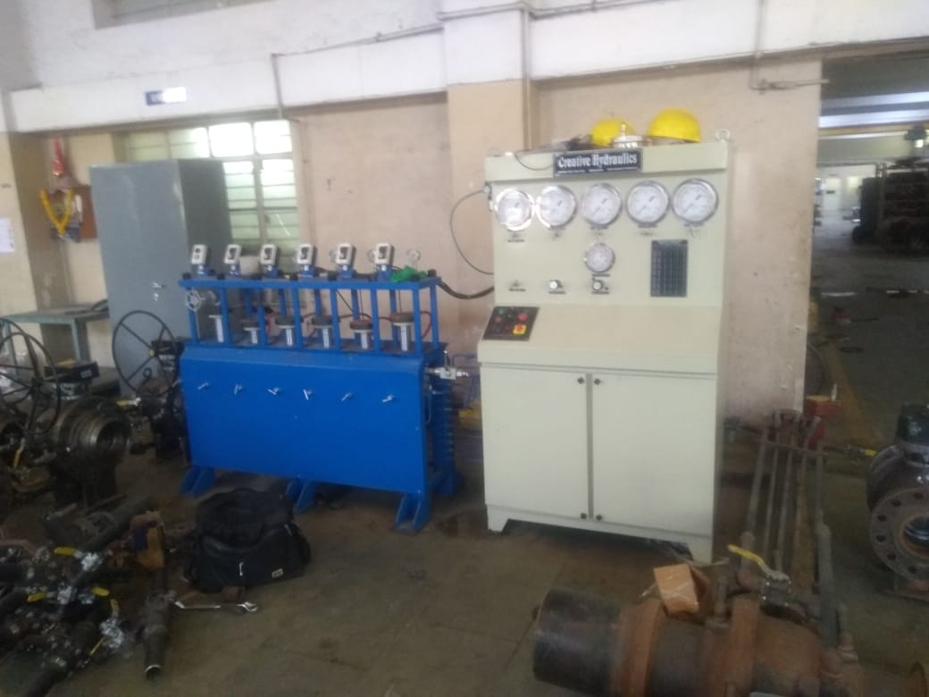
CREATIVE HYDRAULICS
Hydrostatic Compressive Test Rig for Forged valves .Multi stations(6)
Capacity-20 MT
Type of valves- Screwed End /Socket weld end/Butt weld end valves.
Size-1/2” to 2” Class 150 to 2500
Operation-Semi automatic.

Slide 26
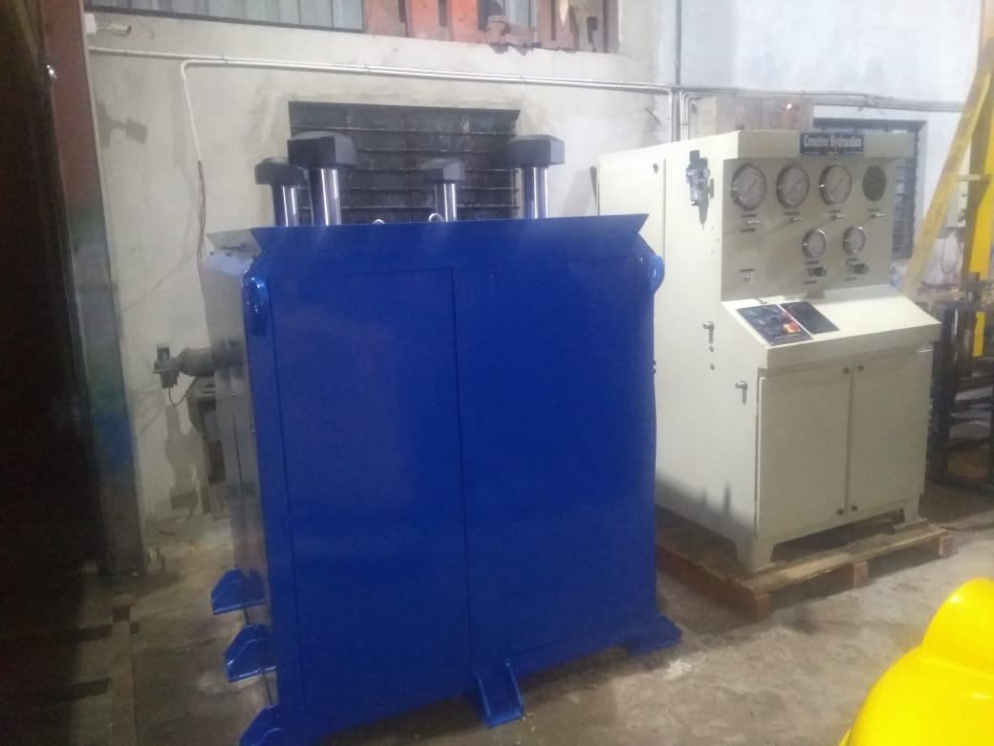
CREATIVE HYDRAULICS
Hydrostatic Compressive Test Rig
Capacity-120 MT
Type of valve –Butterfly valve
Size-10” to 24”
Class- 150,300
Operation-Manual/Semi automatic/Automatic with PLC &SCADA as per customer requirement.

Slide 27
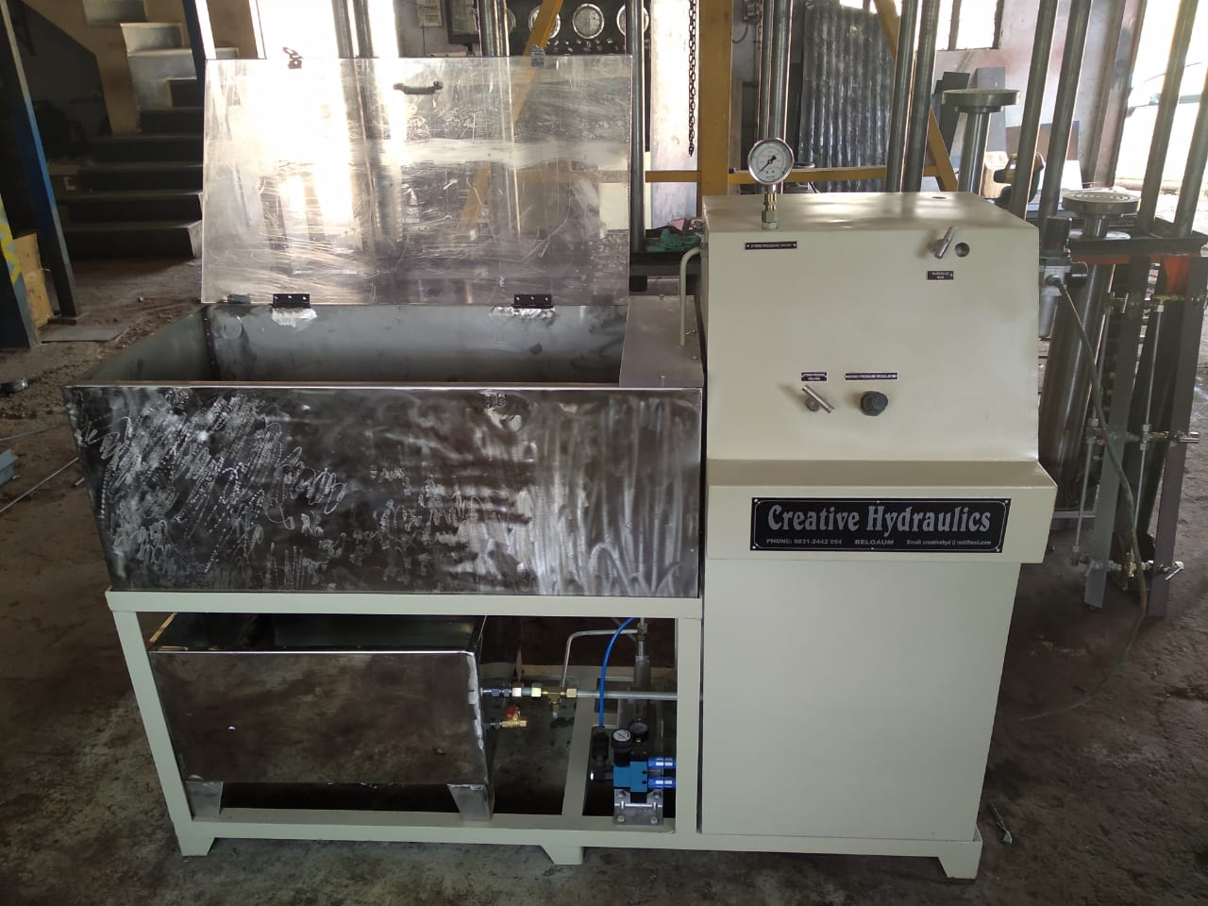
CREATIVE HYDRAULICS
HYDROSTATIC NON COMPRESSIVE TEST RIG
TYPE OF JOBS TO BE TESTED –HOSE PIPES AND TUBES.
CAPACITY- AS PER CUSTOMER REQUIREMENT.
Pressure –class -150 to 2500 as per customer requirement.

Slide 28
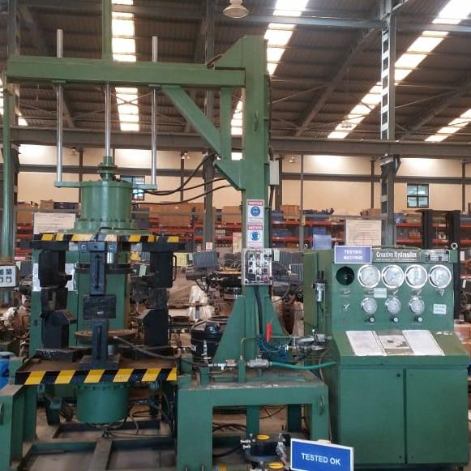
CREATIVE HYDRAULICS
HYDROSTATIC NON COMPRESSIVE TEST RIG OF CAPACITY 150 MT
TYPES OF VALVE TO BE TESTED-FLANGE END VALVES
SIZE-10” TO 16” CLASS 150 TO 300
OPERATION-Manual/Semi auto/Full automatic with PLC Scada as per customer requirement.

Slide 29
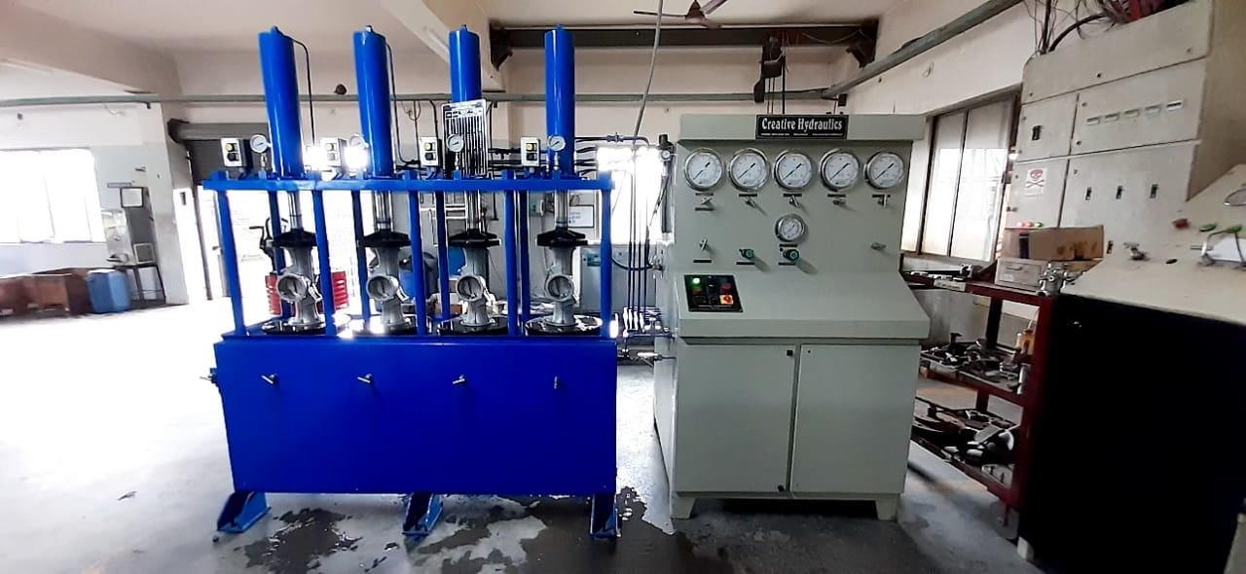
Creative Hydraulics Belgaum
HYDROSTATIC COMPRESSIVE TEST RIG.
CAPACITY-20 MT
TYPE OF VALVE TO BE TESTED- BALL/GATE GLOBE /FORGED VALES AND VALVES BODY.
SIZE- ½ “ TO 4” CLASS 150 TO 2500.
OPERATION-MANUAL
AUTOMAIC PLC AND SCAD BASE AS PER CUSTOMER REQUIREMENT.

Slide 30
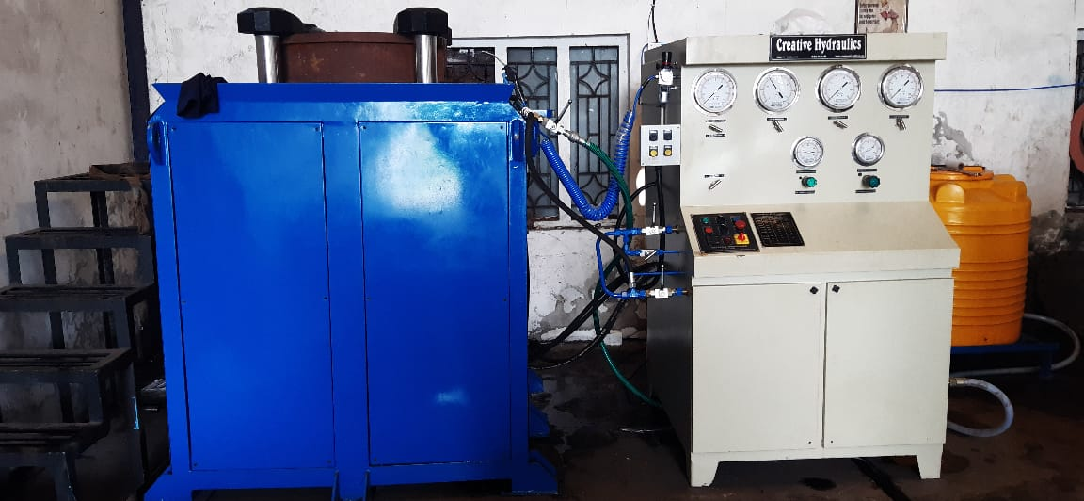
CREATIVE HYDRAULICS BELGAUM
Hydrostatic Compressive Test rig
Capacity-120 MT
Types of valves to be tested- Butterfly valves/Duel plate check valves/Double offset ,Triple offset Butterfly valves.
Size-10” to 24” class 150 to 300
Operation- manual /Semi automatic/Fully automatic with PLC and SCADA. As per customer requirement

Slide 31
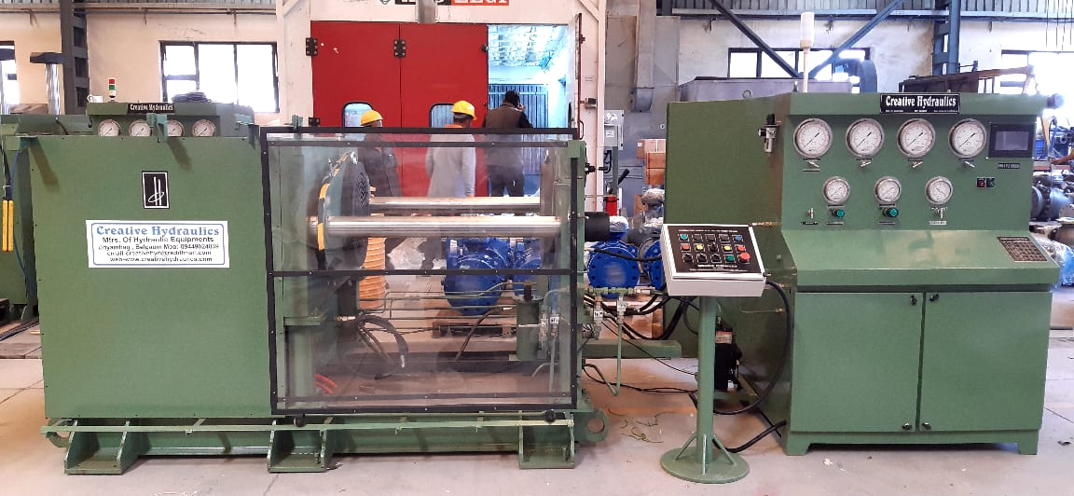
Creative Hydraulics
Belgaum
Hydrostatic Non Compressive Test Rig.
Capacity-150 MT
Types of valves to be tested-TMBV Butt weld ,socket weld ,Gate ,Globe flanged valves.
Size-6” to 12” class 150 to 600
Operation- PLC WITH HMI

Slide 32
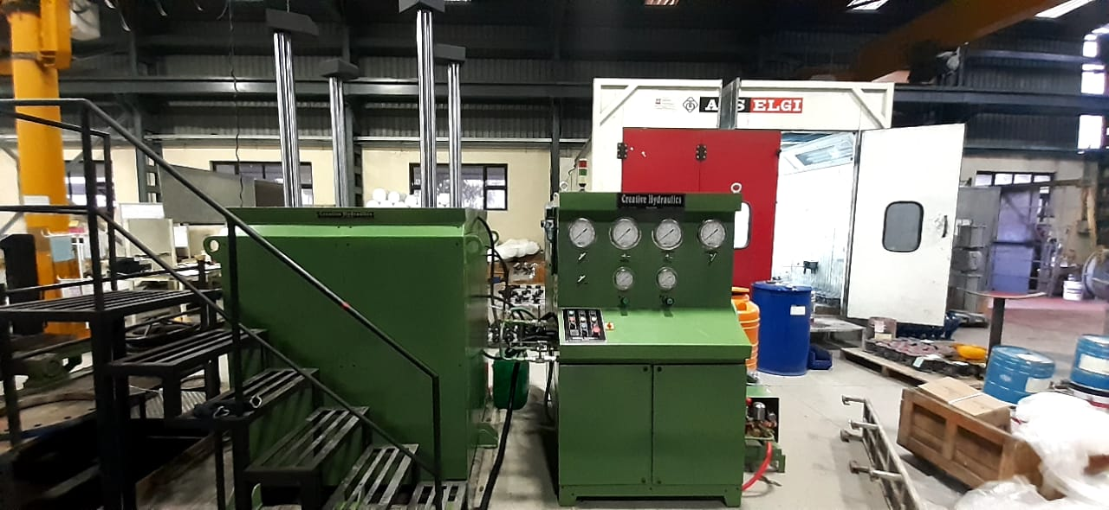
Creative Hydraulics
Belgaum
Hydrostatic Compressive Test bench.
Capacity-300 MT
Types of valves to be tested.
Butterfly valves
Size-10” to 24” Class 150 to 300
Operation- Manual /PLC HMI/PLC SCADA as per customer requirement.

Slide 33
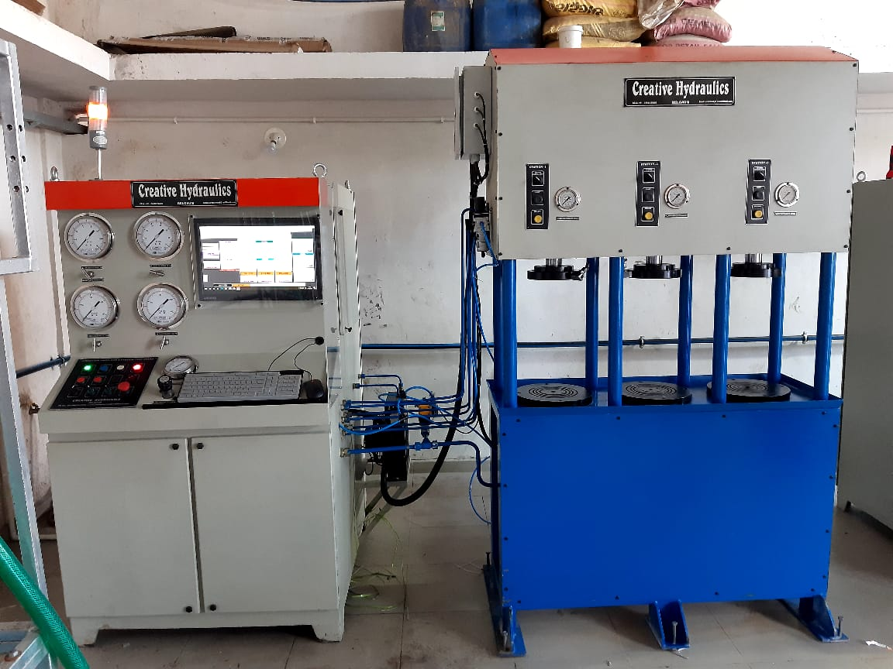
Creative Hydraulics
Belgaum
Hydrostatic Non-Compressive Test Rig. Three Stations.
Capacity-20 MT
Types of valve to be tested- Flange end ball valve /SE valves /Socket end valves.
Size-1/2” to 2” class 150 to 2500
Operation – PLC and SCADA fully automatic .

Slide 34
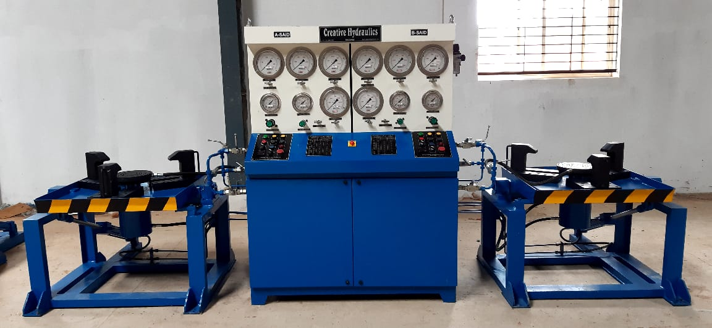
Creative Hydraulics Belgaum
Hydrostatic Non compressive Test Bench. Two stations.
Capacity-40 MT
Types of valve to be Tested- Flange end valves Ball/Gate /Globe valves.
Size-2” to 6” class 150 to 600.
Operation- Manual/Semi automatic/ Fully automatic. PLC SCADA.

Slide 35
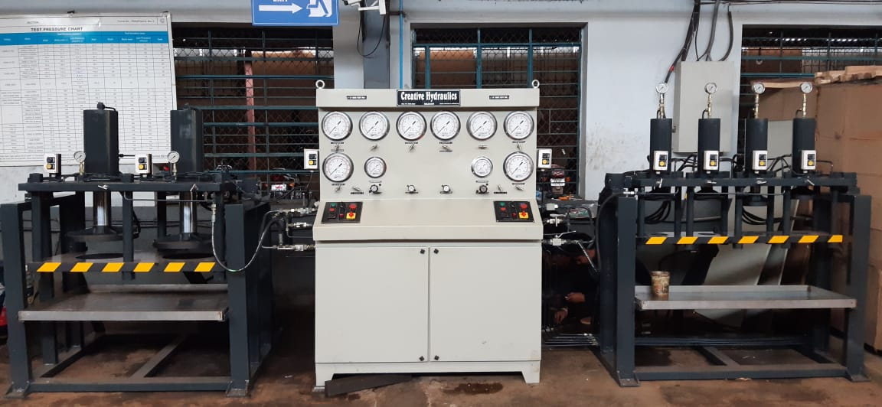
Creative Hydraulics Belgaum
Hydrostatic Compressive Test benches Two stations.
Capacity- 20 MT and 40 MT
Types of valves to be tested. DCV
Size- ½” to 4” class PN 10 PN 16
150. And 6” to 12” class 150 to 300
Operation –Manual /Semi auto/ Fully automatic.PLC with scada.

Slide 36
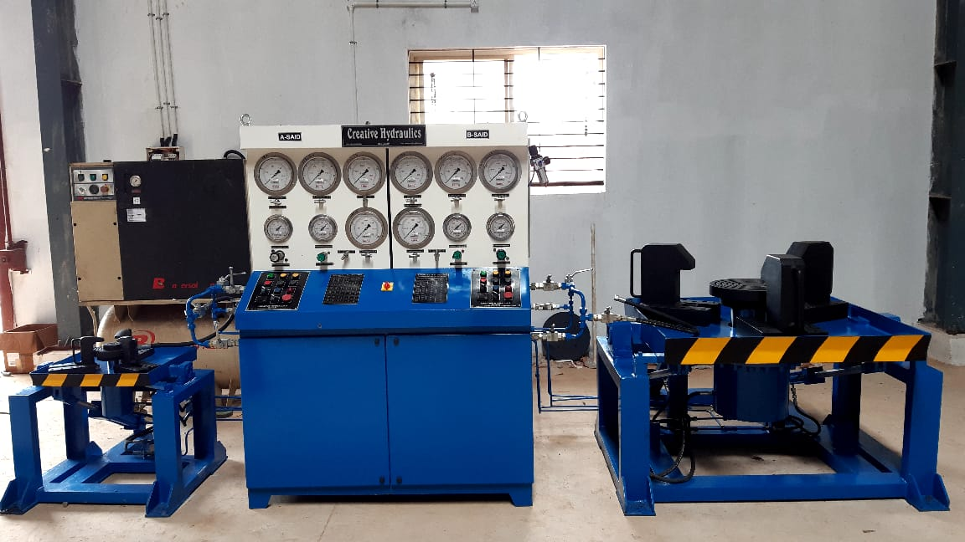
Creative Hydraulics Belgaum
Hydrostatic Non compressive Test benches. Two stations.
Capacity-20 MT and 150 MT
Valves to be tested- Flange end valves Gate /Globe /Ball valves.
Size- ½” 4” class 150 to 600 and 6” to 12” class 150 to 600.
Operation- Manual/Semi auto/ Fully automatic PLC SCADA.

Slide 37
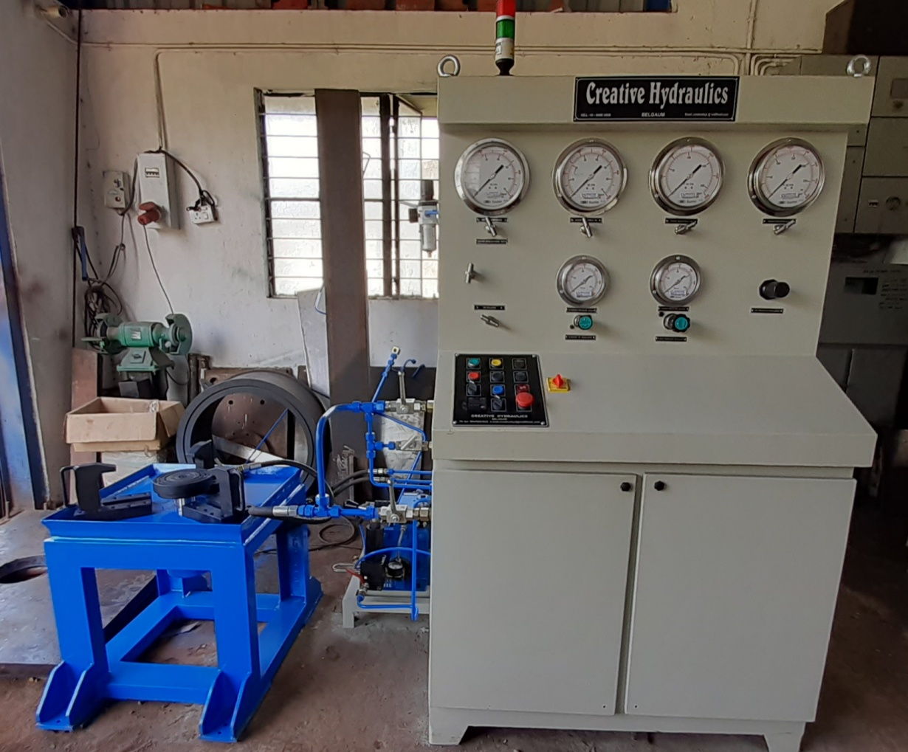
Creative Hydraulics Belgaum
Hydrostatic non compressive Test benches. Single station.
Capacity- 20 MT
Valves to be tested- Control valves, Safety valves
Size-1/2” to 6” class as per customer requirement.
Operation- Manual/ Semi automatic/ Fully Automatic PLC SCADA.

Slide 38
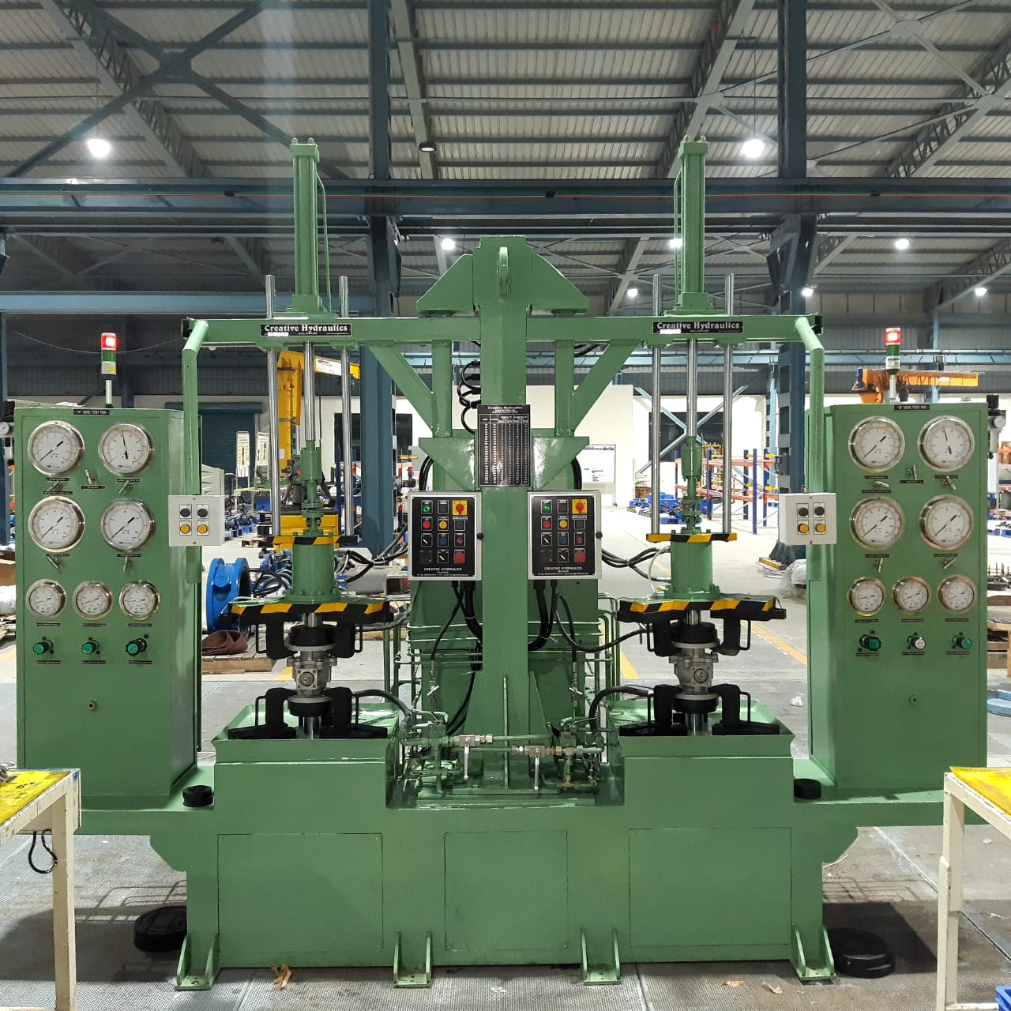
Creative Hydraulics Belgaum
Hydrostatic Non compressive Test bench Two stations.
Capacity- 20 MT Each
Valve to be tested- Flange end valves.
Size- ½” to 4” Class 150 to 600.
Operations- Manual/Semi automatic/Automatic with PLC & Scada base.

Slide 39
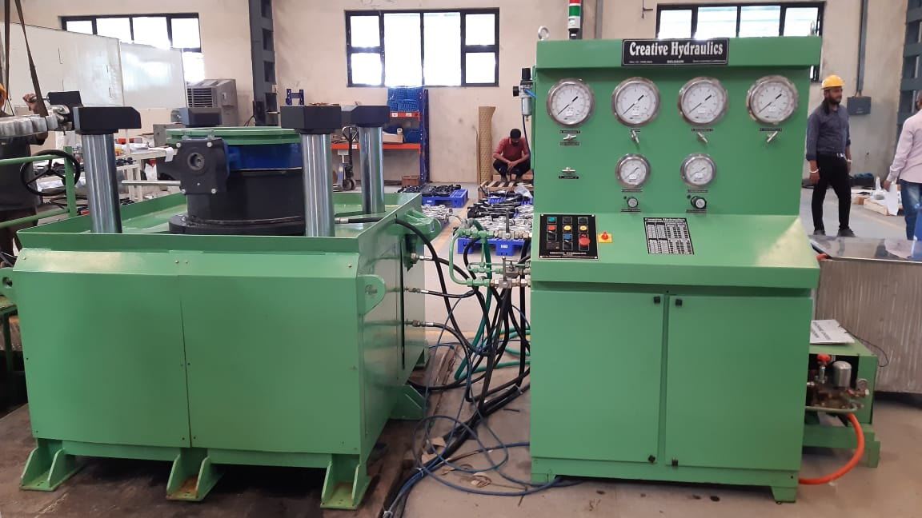
Creative Hydraulics Belgaum
Hydrostatic Compressive Test bench.
Capacity-300 MT
Valve to be tested.-Butterfly valves
Size-14” to 24” class -150 to 300
Operation-Manual/Semi automatic/ Full automatic with PLC & SCADA base.

Slide 40
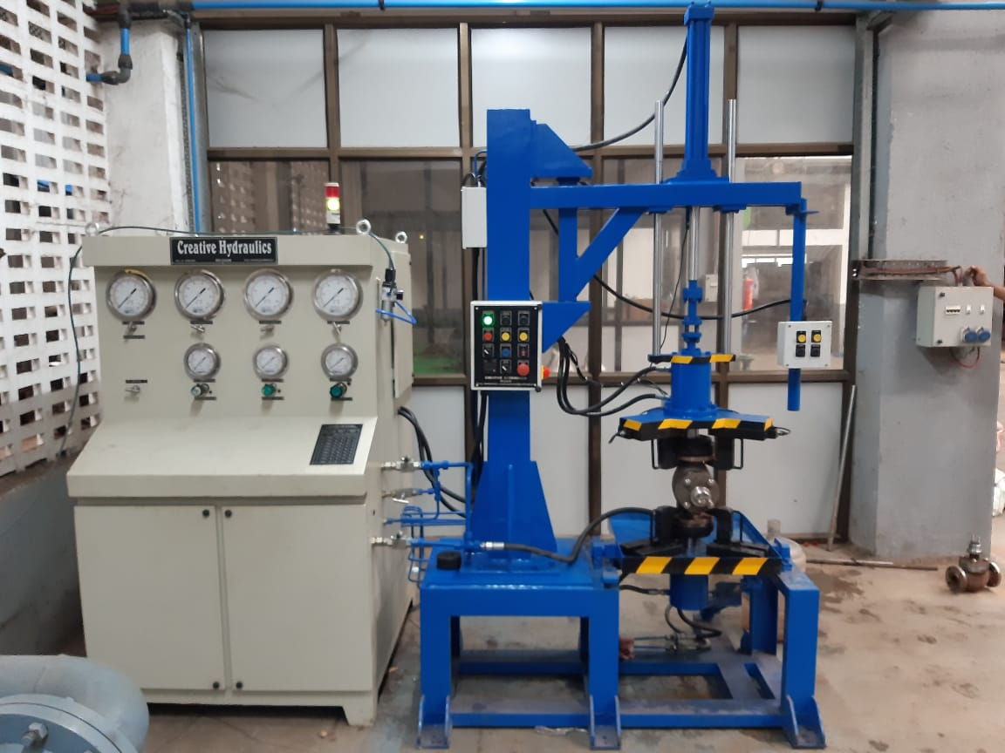
Creative hydraulics Belgaum
Hydrostatic Non-Compressive Test bench.
Capacity-20MT
Valve to be tested- Flange end valves.
Size-1/2” to 4” class 150 to 600 and 6” class 150 only.
Operation –manual/Semi auto/Automatic with PLC/SCADA as per customer requirement.

Slide 41
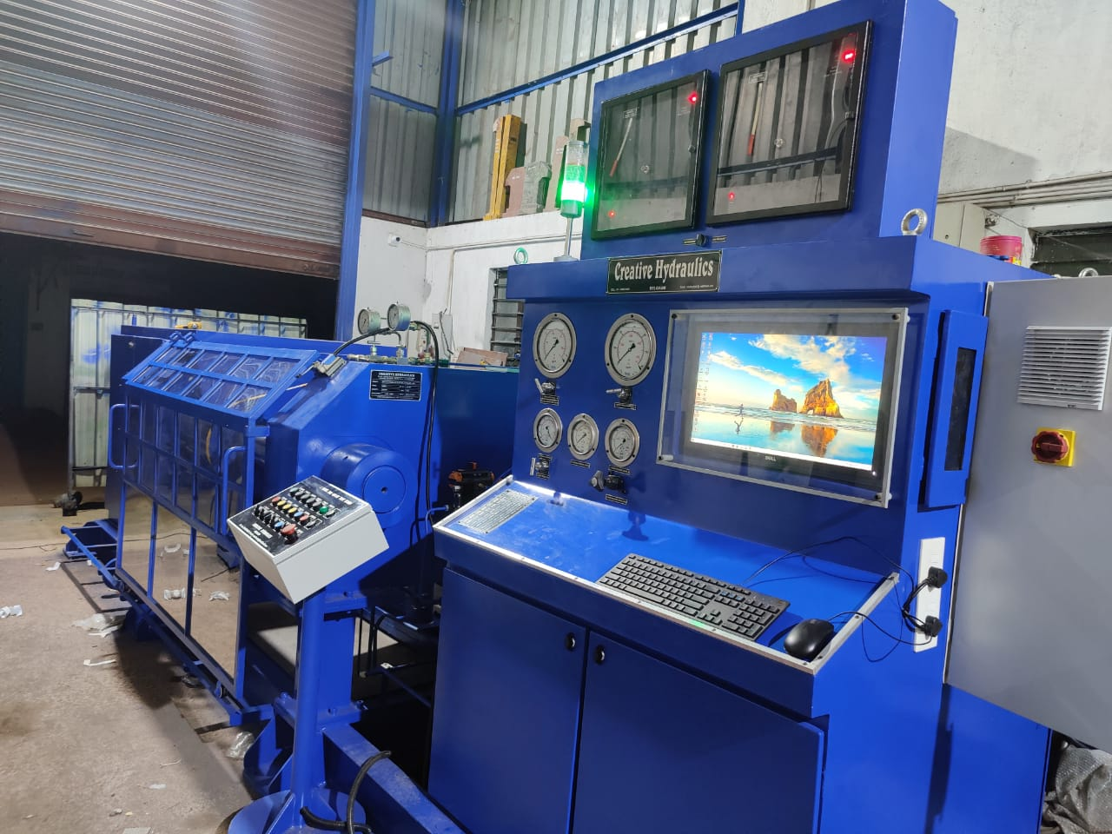
Creative Hydraulics Belgaum
Hydrostatic Non compressive Test bench.
Capacity-400 MT
Types of valves to be tested.-Flange end Ball valves.
Size-2” to 12” class 150 to 1500
Operation –Fully automatic with PLC and SCADA.

